Slide 1
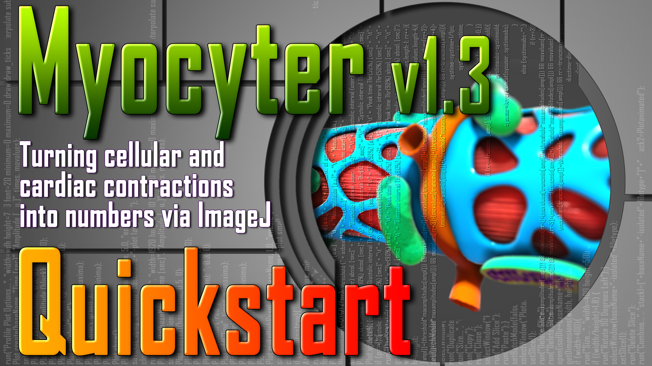

Slide 2
MYOCYTER v1.3 – Hard- and software
Please be aware that ImageJ and FIJI require lots of RAM (16 GB+) for processing of large and/or high-resolution video material.
MYOCYTER requires a Windows-based operating system like Win7 or Win10.
Use of „MacOS“ or „OS X“ may cause dysfunction of our software.

Slide 3
MYOCYTER v1.3 – Quickstart
This is the quickstart manual of MYOCYTER v1.3, which sets out its workflow as short
as possible.
MYOCYTER is a macro for the free image processing software „ImageJ“, enabling extraction
of an unmatched amount of parameters from videos of contracting cells like (cardio-)myocytes.
Please read the complete quickstart first to familiarize yourself with the possibilities of the software and to be able to decide which settings are best suited for your samples/data.
For a better insight into the technological background, implementation of
different features and the effects of the available settings, please take a look in the
much more detailed manual.
The latest version of MYOCYTER, the quickstart, the detailed manual and several videos for testing purposes can be found here: www.scyrus.de
You may also visit our YouTube-channel or discuss the macro on GitHub.

Slide 4
The Workflow of MYOCYTER v1.3
1. Pretest
This is both the menu and the typical workflow of MYOCYTER v1.3 during data extraction from videos
and further processing.
2. Create a Batchlist
3. Manual ROI selection
4. Evaluation
5. Exclude Data
6. Re-Evaluation
7. Data Extraction

Slide 5
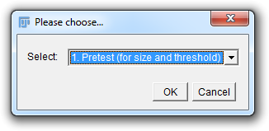
The Workflow of MYOCYTER v1.3
0. Before you start
You have all you videos in an ImageJ-compatible format (MJEPG or uncompressed *.avi files) in a folder.
You need ImageJ v. 1.52q (or higher).
You need the MYOCYTER-Macro as *.txt file.
A computer with ≥16 GB of RAM and a 64-bit Windows-OS is recommended.
Open the file containing the macro code, copy it and start ImageJ.
Select „Plugins“ → „Macros“ → „Record“.
Paste the code into the new window („Recorder“), click the „Create“-button and close the „Recorder“-window.
The macro code is now in a new window („Macro.ijm“). Select „Macros“ → „Run Macro“ (or press „Strg+R“).
MYOCYTER starts and you should see its user-interface.

Slide 6
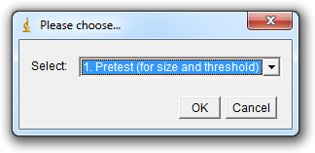
The Workflow of MYOCYTER v1.3
1. Pretest
The pretest assures optimal recognition of contracting cells and exclusion of the background.
Select the first option „1. Pretest (for size and threshold“ from the user interface and click „OK“.

Slide 7
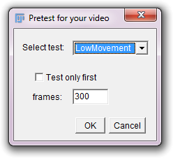
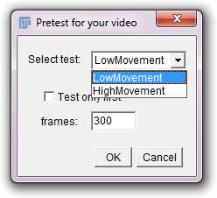
The Workflow of MYOCYTER v1.3
1. Pretest
Stick with the default settings (for the beginning).
Select the folder containing your videos, DO NOT open it, click „OK“ and wait until the macro finished.
A new folder („pretest“) should be found in the folder containing your videos.
Default
settings
Use „LowMovement“ for cells that show not much contraction – which setting to use comes with some experience.
To save time, pretest only the
first xxx frames of your video

Slide 8
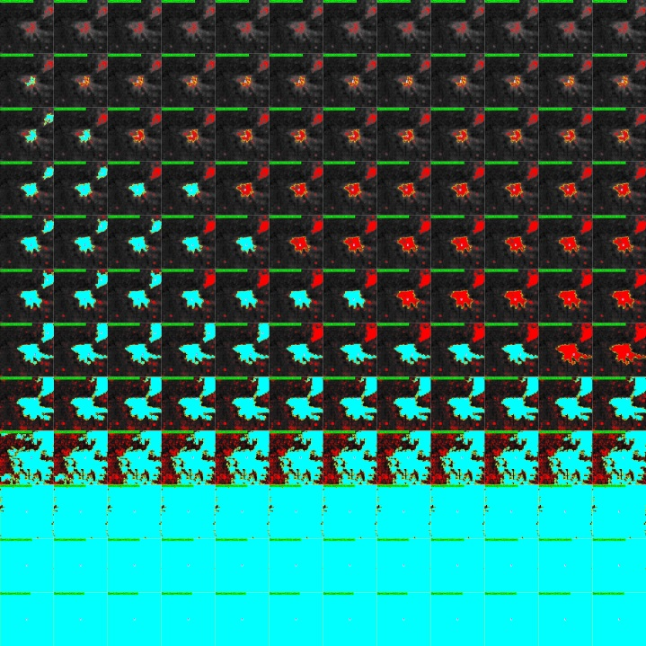
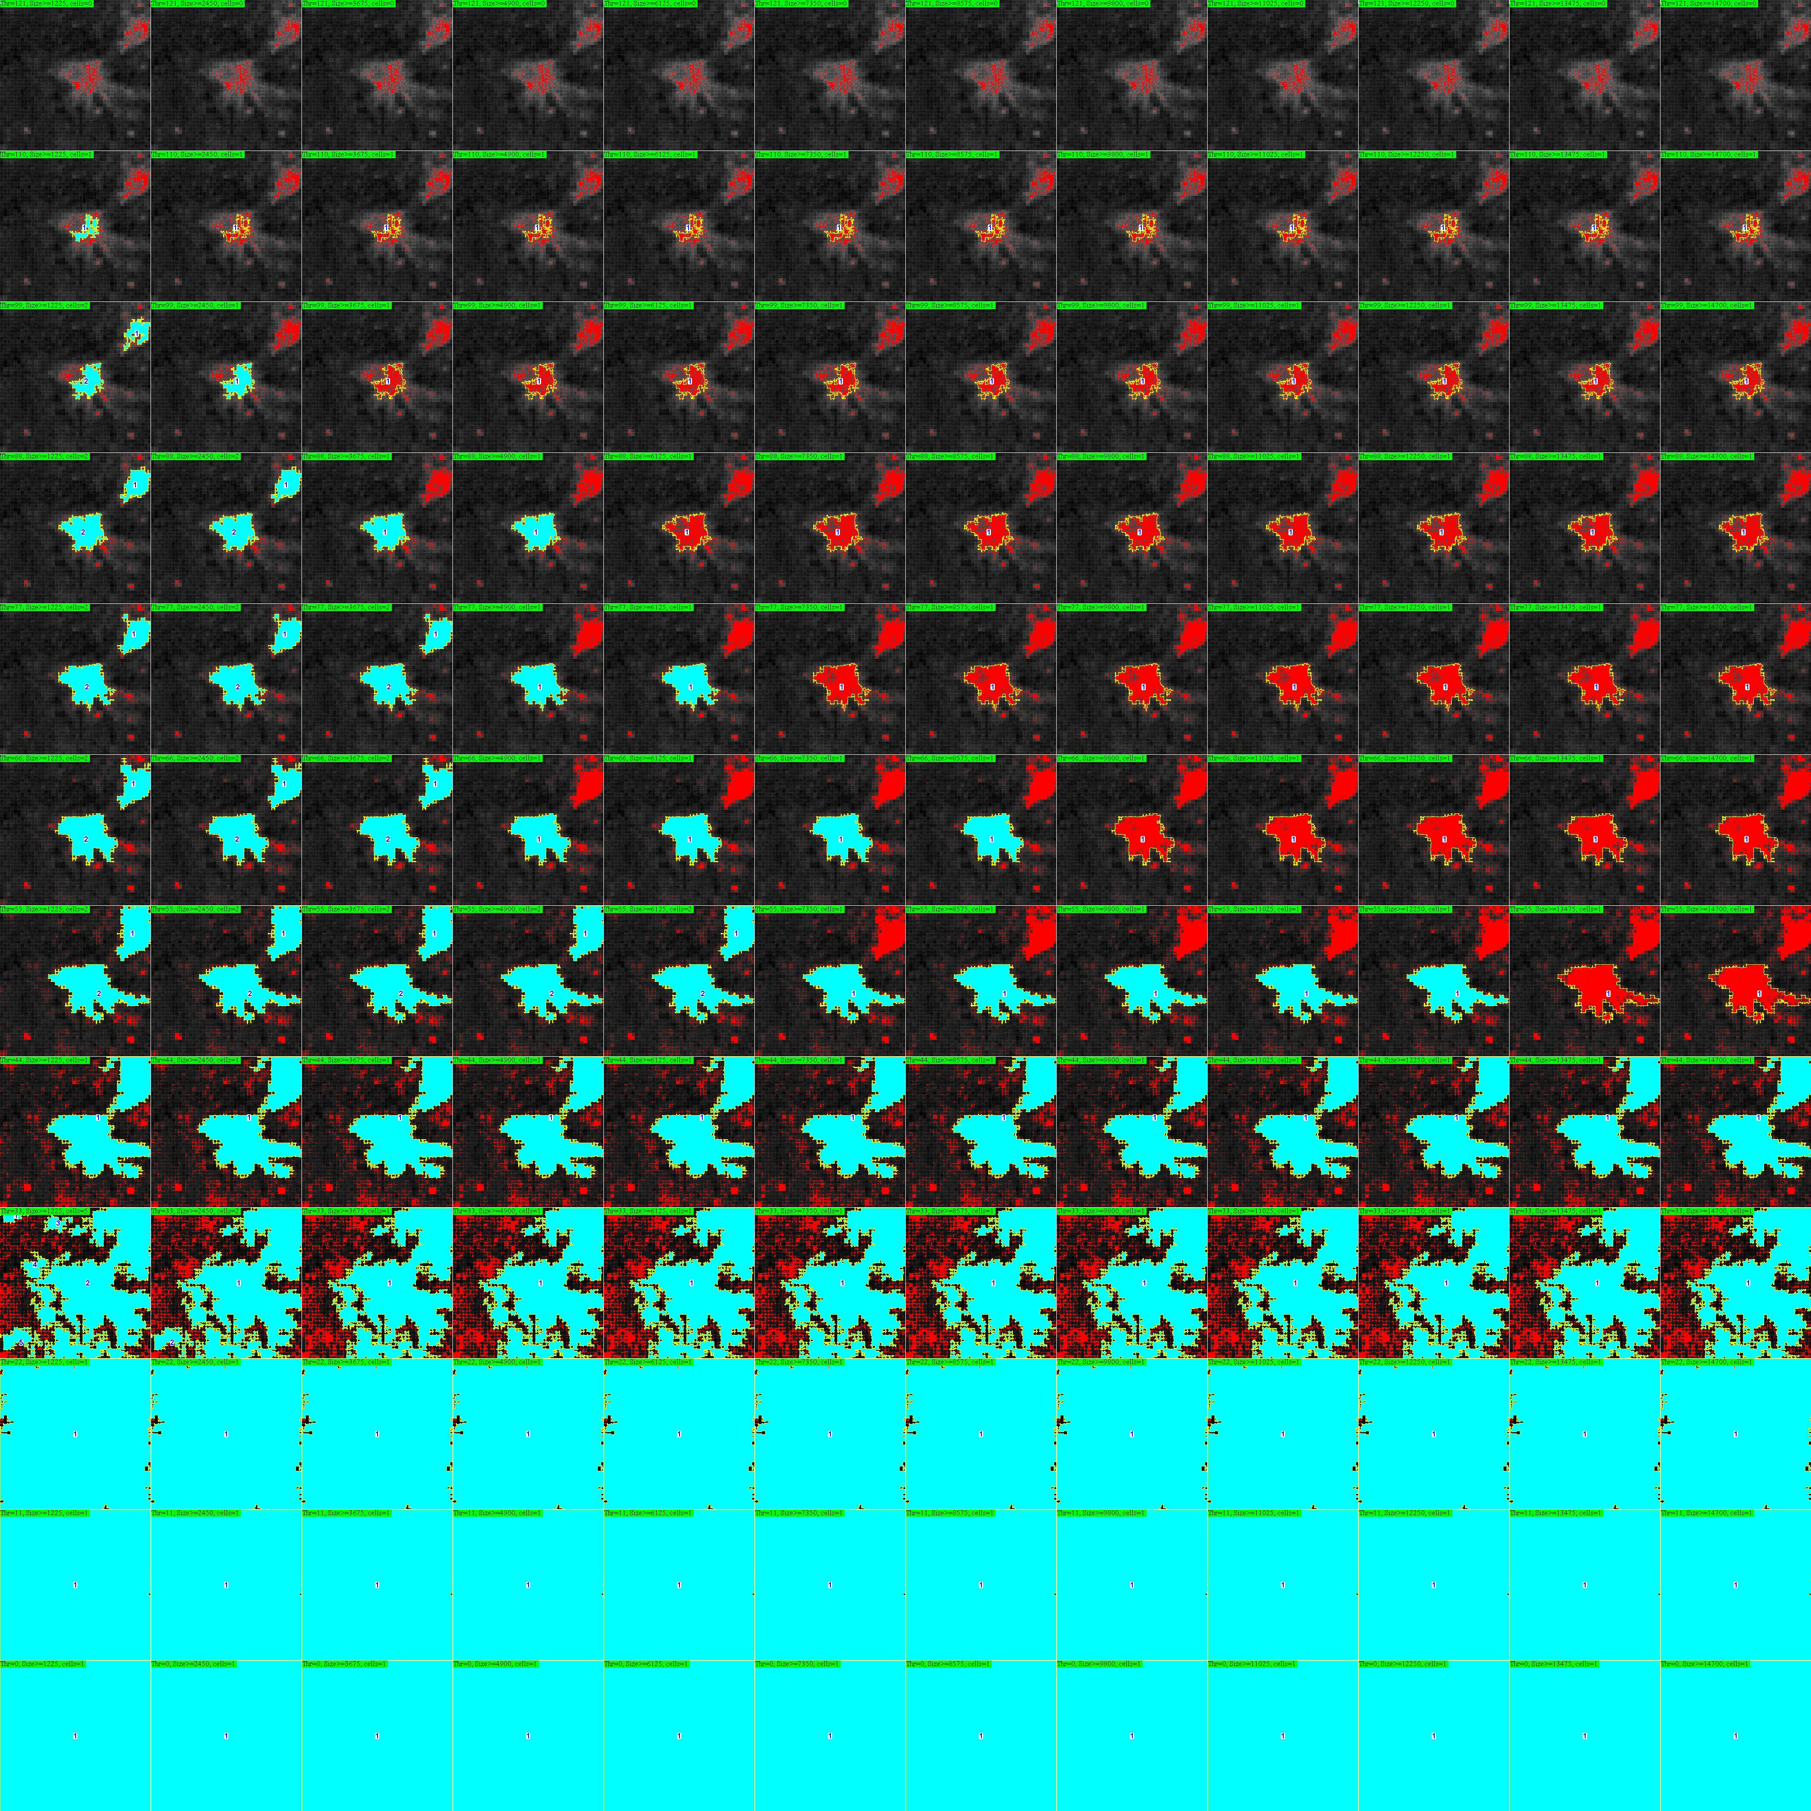
The Workflow of MYOCYTER v1.3
1. Pretest
The images of the pretest should look like this:
Two cells have been recognized. To restrict evaluation to the moving cells only, we sould apply (in this case) a Threshold of 55 and a Size of 2450.
Only the turquoise areas will be evaluated with the according settings, while the background is completely excluded.

Slide 9
The Workflow of MYOCYTER v1.3
1. Pretest
The images of the pretest should look like this:
Two cells have been recognized.
To exclude the one cropped through the picture frame, apply a Threshold of 55 and a Size of 8575.
Only the turquoise areas will be evaluated with the according settings, while the background is completely excluded.

Slide 10
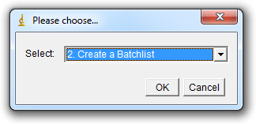
The Workflow of MYOCYTER v1.3
2. Create a Batchlist
Application of individual settings for Threshold and Size from „1. Pretest“ to every single video can be completely automatized.
Select option „2. Create a Batchlist“.
Just select the folder containing your pretest images, DO NOT open it.
Click „Okay“.

Slide 11
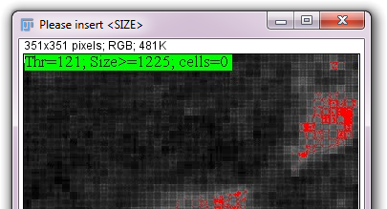
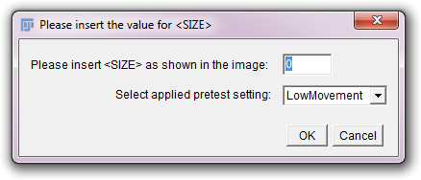
The Workflow of MYOCYTER v1.3
2. Create a Batchlist
An image opens and you will be asked to insert the „Size“-value (left image) into the according field (right image).
Please type the value for „Size“ in this field (in this case 1225).
This has to be done only once.
NOTE: All videos in the folder should have same dimensions!
After this, please select „LowMovement“ or „HighMovement“ – depending on your pretest settings. This information is also given in the name of the folder containing the pretest images. For example: „pretest (LowMovement) 2019-Sep-21 22h09“.
Click „OK“ to start selection of the individual settings.

Slide 12
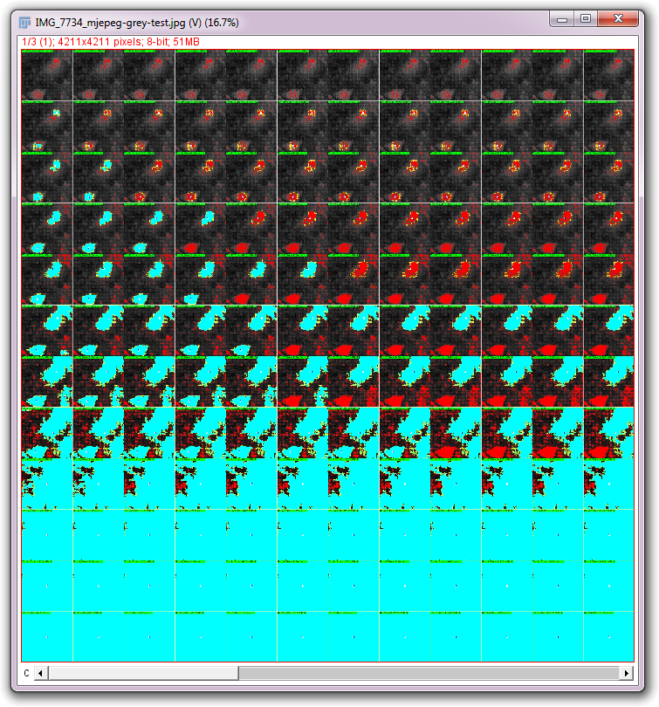
The Workflow of MYOCYTER v1.3
2. Create a Batchlist
Now, just left click the panel of the pretest images matching the settings you want to apply.
Just left click the desired panel (small images).
To magnity the image, you can use the mouse wheel while pressing „Strg“.
After selection, the current pretest image will be closed and the next one opens automatically until every single one has been processed.

Slide 13
The Workflow of MYOCYTER v1.3
2. Create a Batchlist
After processing the last pretest image, the individual settings will be found as table (batch.txt) in the pretest folder.
Copy this file (batch.txt) into the folder containing your videos.
Using the file batch.txt, MYOCYTER applies individual settings for every single video during evaluation. ONLY the videos actually listed in this file will be processed.

Slide 14
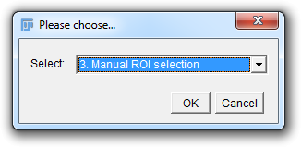
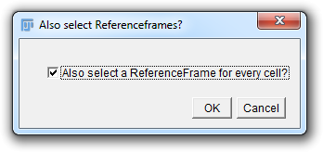
The Workflow of MYOCYTER v1.3
3. Manual ROI selection
Select „3. Manual ROI selection“ and click „OK“.
This feature enables manual outlining and labelling of cells without any pretest.
Just select (do not open) the folder containing your videos, click „OK“.
In the next step you will be asked about (manual) selection of a reference frame for every single defined cell. In most cases, you can uncheck this feature, because automatic recognition is quite reliable and robust.

Slide 15
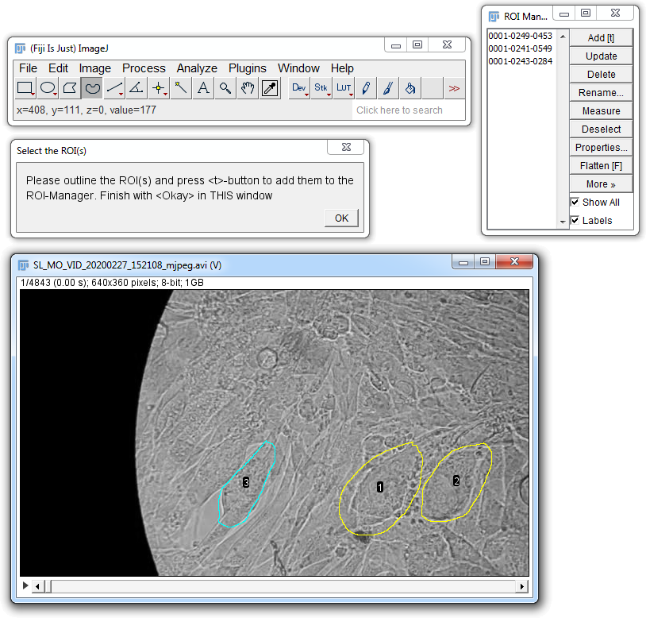
The Workflow of MYOCYTER v1.3
3. Manual ROI selection
Now, please select (do not open) the folder containing your video-files.
Every single file will be opened successively and the user is asked to outline single cells.
Pick one of the selection tools (red circle).
Label the first cell (see video-panel) and press the „t“-key to assign the selection to the „ROI Manager“ (top right panel). Repeat for every single cell to be analyzed.
To finish the current video, click „OK“ in the „Select the ROI(s)“-window (green circle).

Slide 16
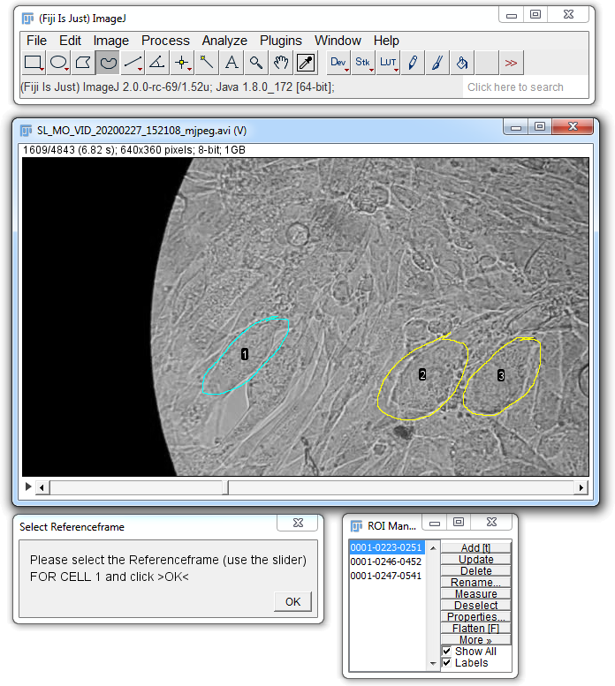
The Workflow of MYOCYTER v1.3
3. Manual ROI selection
IF you checked „Also select a ReferenceFrame for every cell“ at the beginning, you are asked to adjust the according reference frame for every single selection using the slider of the video (blue circle) after defining the indicidual ROIs.
Define the appropriate reference frame for every single ROI (red circles) using the slider of the video-frame, then click „OK“ (green circle) to proceed to the next ROI.

Slide 17
The Workflow of MYOCYTER v1.3
3. Manual ROI selection
Repeat this selection of ROIs and also reference frames (if you activated this option) for every single video.
MYOCYTER will terminate after the last file, and a „manrois“-subfolder is created in the folder containing your videos.
How this manual ROI selection is used during evaluation is explained in the next section (4. Evaluation).

Slide 18
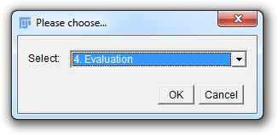
The Workflow of MYOCYTER v1.3
4. Evaluation
Select „4. Evaluation“ and click „OK“.

Slide 19
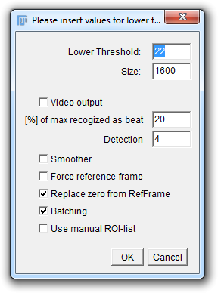
The Workflow of MYOCYTER v1.3
4. Evaluation
Creates an animated plot of every single recognized cell synchronized with its amplitude. This takes time, so you may apply this feature only to selected videos.
If you have only a single video or videos with very similar cells, you can apply pretest-values for Threshold and Size directly here without creating a batch-list and deselect „Batching“.
If you want to evaluate the whole frame without restriction to the moving cells only, apply a Threshold of 0 (Sizes becomes irrelevant in this case) and deselect „Batching“.
Higher values will recognize smaller amplitudes as contractions. Can be changed even after evaluation.
If checked, you will be asked to define the resting state of every single cell manually. Usually, automatic recognition of the reference-frame works very fine, so this field ca be left unchecked.
If the amplitude exceeds this value (here: 20%) of its lokal peak, the times for systole and diastole are measured. The values 10, 50 and 90% are applied anyway. This value can also be changed even after evaluation.
Activate „Batching“ if you want to use a Batch List; the values for „Lower Threshold“ and „Size“ can be ignored and are over-written by the individual ones of the list.
Check this option to use the manual ROI-selection created in section „3. Manual ROI selection“.

Slide 20
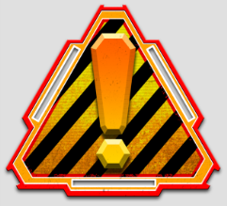
The Workflow of MYOCYTER v1.3
4. Evaluation
After applying the desired settings for evaluation, click „OK“.
Just select the folder containing your videos (and also the file „batch.txt“, if you selected „Batching“), DO NOT open it.
Evaluation may take some time, depending on filesize and number of your videos. After finishing evaluation ALL windows will be closed automatically.
Please, DO NOT use the computer for any other task during evaluation – this may lead to premature termination of MYOCYTER.

Slide 21
The Workflow of MYOCYTER v1.3
4. Evaluation
If you want to apply manual ROIs (see section 3.), please check the option „Use manual ROI-list“.
First, you may see a „warning“ that „batching“ was deactivated. This is just a hint that batch-lists will be ignored, click „OK“ to go on.
First, you are asked to select the folder containing your videos (just select, do not open it).
Second, you are asked to select (not open) the „mainrois“-folder containing the ROI-data (please see section 3 for details).

Slide 22
The Workflow of MYOCYTER v1.3
5. Exclude Data
After evaluation, new folders are created in the one containing your videos: This folder should have the subfolders „diffMov“ → „dataplots“.
The folder „dataplots“ contains (amongst other things) plots of the amplitude of every single recognized cell as well as a text-file named „Results“.
Possibly also cells were evaluated the user wants to exclude from further analytics - nobody wants to do this manually in a table that contains many thousands of lines.
This process (excluding data) is largely automatized, the original data remain untouched.

Slide 23

The Workflow of MYOCYTER v1.3
5. Exclude Data
Select „5. Exclude Data“ and click „OK“.
Just select the „dataplots“ folder created after evaluation (DO NOT open it), containing the amplitude plots and the „Results“ (as text file).
After selecting/excluding your data, you will be asked again to choose another „dataplots“ folder to continue excluding until you terminate the macro.

Slide 24
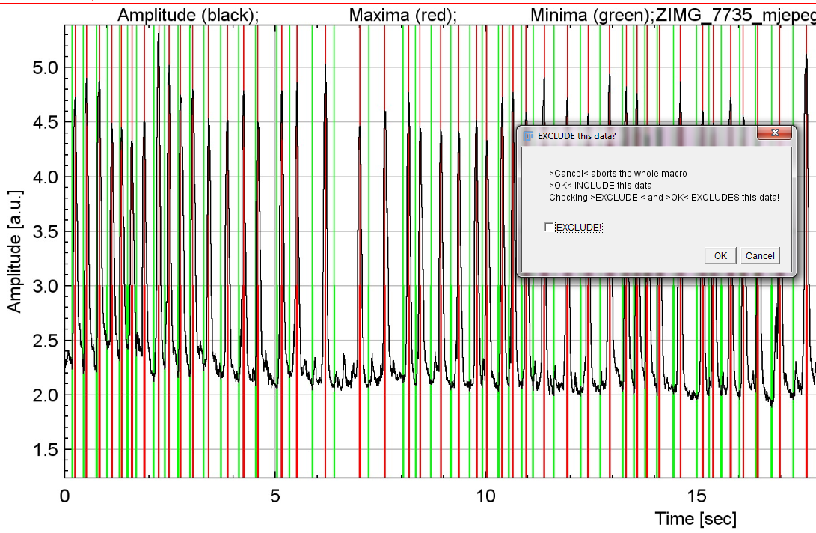
The Workflow of MYOCYTER v1.3
5. Exclude Data
Now, you will be asked to decide for every single recognized cell if the according data should be EXCLUDED.
Click „OK“ to INCLUDE the shown dataset.
Check „EXCLUDE“ and click „OK“ to EXCLUDE it.

Slide 25
The Workflow of MYOCYTER v1.3
5. Exclude Data
A new file is generated in the „dataplots“ folder: „Results (selected)“. This file contains only the data you included as well as a list of the excluded data.
You can now process/compare this data table in a stats software.
The original data remain unchanged.

Slide 26

The Workflow of MYOCYTER v1.3
6. Re-Evaluation
Using „6. Re-Evaluation“, you can apply changed settings to your data, even after evaluation.
Select „6. Re-Evaluation“ and click „OK“.
Go to the „dataplots“ subfolder of your evaluation, open it, select the „Amplitudes only“ text file, click „OK“ to open it.

Slide 27
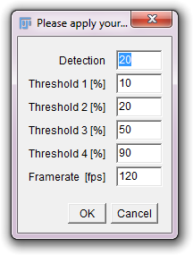
The Workflow of MYOCYTER v1.3
6. Re-Evaluation
Now, you are asked to apply other settings to your evaluated data.
Higher values for „Detection“ include smaller local maxima as detected peaks/contractions.
Apply four different thresholds to the extracted amplitude. Please see the manual for details.
Change the detected framerate of the video (if necessary).

Slide 28
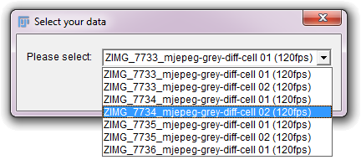
The Workflow of MYOCYTER v1.3
6. Re-Evaluation
And to select the dataset (a single cell, in this case) you want to re-evaluate.
Every single cell from your evaluation is listed here – just pick one.

Slide 29
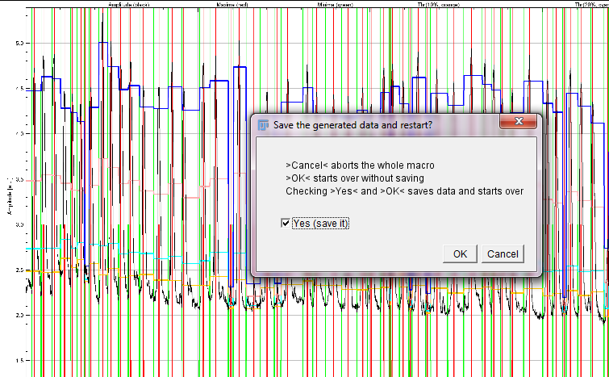
The Workflow of MYOCYTER v1.3
6. Re-Evaluation
Save or discard the (new) dataset after re-evaluation:
Check „Yes“ and click „OK“ to save the new plot as well as the new results table.
Just click „OK“ to restart re-evaluation with other settings and data (without saving).

Slide 30
The Workflow of MYOCYTER v1.3
6. Re-Evaluation
All re-evaluated data will be stored both as plots: old filename + „re-evaluated“ and the current date and time (JPEG-format) and also as a single data table: „Amplitudes only“ + „re-revaluated“ and the current date and time (text file).

Slide 31
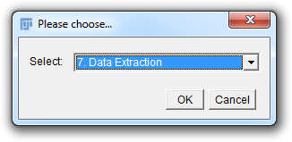
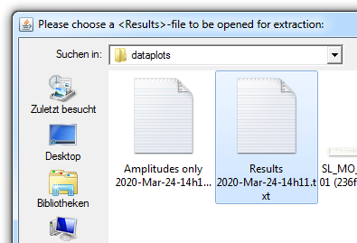
The Workflow of MYOCYTER v1.3
7. Data Extraction
Evaluation provides both „continuous“ data for plotting (like the amplitude over time) or „discrete“ data (like only the maximum amplitudes for every single contraction) for statistics.
This feature enables extraction of ALL „discrete“ data from a „Results“-file for further data processing in statistical software.
First, you are asked to select the according „Results“- or „Results (selected)“-file (found in the „dataplots“-folder).
Klick „OK“ to open it.

Slide 32
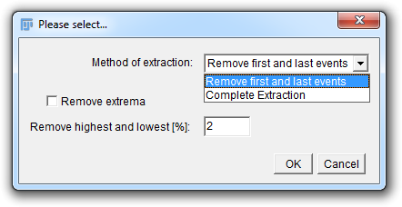
The Workflow of MYOCYTER v1.3
7. Data Extraction
In the next step, you determine the method of data extraction.
„Remove first and last events“: The discrete data are completely extracted, both first and last „events“ (contractions) of every single recognized cell/structure are removed.
„Complete extraction“: The discrete data are completely extracted (including first and last „events“).
„Remove highest and lowest [%]“: Here, you can define the percentage of maxima that is removed. In this case, „2“ will result in remove of both the 2% highest and lowest values. This option also sorts all values by size.

Slide 33
The Workflow of MYOCYTER v1.3
7. Data Extraction
The extracted data („Extracted results“) are stored in the same folder as the according „Results“-file.
After this, MYOCYTER will immediately ask for the next „Results“-file to process until you terminate the macro.

Slide 34

The Workflow of MYOCYTER v1.3
7. Data Extraction
Please note:
14 different discrete parameters from the whole file will be extracted completely, without any information about the according files and recognized cells.
This feature is only useful if ALL cells in the according „Results“-file are from the same group and should be compared to another group (like „Control“ and „Treatment“).
Two different files are generated and stored in the folder of the „Results“-file: „Extracted results (eng)“ (points as decimal separators) and „Extracted results (ger)“ (commas as decimal separators)
The data are arranged for direct copy/paste transfer into a statistics software.

Slide 35
Please cite us when you use MYOCYTER
If you use our macro, please cite the according peer-reviewed publication:
“The MYOCYTER – Convert cellular and cardiac contractions into numbers with ImageJ”,
Grune, T.; Ott, C.; Häseli, S.; Höhn, A.; Jung, T., ScientificReports, October 2019.
If you have any questions about MYOCYTER, please contact me:
Tobias Jung, e-mail: tobias.jung@dife.de
Phone: +49 (0)33200 88-2490
German Institute of Human Nutrition Potsdam-Rehbruecke (DIfE) Arthur-Scheunert-Allee 114-116 14558 Nuthetal, Germany

